Slide 1
Unit 14 “Global Surveillance & International
Health Regulations”
Notes:
Welcome to Unit 14, entitled “Global Surveillance and International Health Regulations”. This lecture will provide an overview of global health surveillance efforts, surveillance in low-resource settings, International Health Regulations or IHR and will conclude with COVID-19 as a case example of a Public Health Emergency of International Concern.

Slide 2

Review: Types of Global
(International) Surveillance
Course objective: identify 3 types of
international (global) surveillance
Unit 11: surveillance for HIV/AIDS
Unit 12: Vaccine-preventable diseases
Units 13 & 8: both national & international foodborne illness surveillance
Unit 14: Global Disease Detection & International Health Regulations
Notes:
One of this courses’ objectives is that upon completion of the course, you will be able to identify at least three types of international (global) surveillance. In Unit 11, Surveillance for HIV/AIDS, we learned about the many sources of HIV surveillance data, from local to state to national and global levels. In Unit 12, we discussed national and global surveillance for vaccine-preventable diseases and for immunization coverage. In Unit 13, we learned about foodborne illness surveillance in the United States, while in Unit 8 you participated in an international foodborne outbreak exercise. In Unit 14, we will cover Global Disease Detection and International Health Regulations.

Slide 3
Importance of Global
PH Health Surveillance
Critical to identify &/or prevent emerging/reemerging/infectious/non-communicable diseases
Important to provide timely health info.
PH problems addressed effectively
by surveillance systems
Examples: smallpox & polio
Notes:
Global public health surveillance is critical for the identification and prevention of emerging and reemerging diseases, both for infectious and noncommunicable diseases that account for the greatest burden of diseases, even in low resource settings. It should provide health information in a timely manner so that countries have the information that they need to fight epidemics now or to plan for the future. Several public health problems have been addressed effectively by the development and maintenance of surveillance systems. One example is smallpox, which was eradicated through a switch in strategy from mass vaccination to surveillance with rapid response. In the poliomyelitis eradication campaign, the world is covered effectively by an integrated surveillance system that channels specimens rapidly to genotyping within days to weeks.

Slide 4
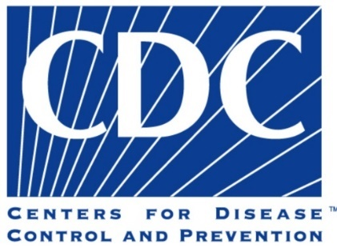
Global Disease Detection
(GDD) Program
GDD part of DGHP at CDC
rapid detection, identification & prompt containment of emerging infectious diseases
& bioterrorist threats
global health security
requires cooperation
Notes:
An additional type of global/international surveillance that we will discuss next is Global Disease Detection. The Global Disease Detection (GDD) program is CDC’s principal and most visible program for developing and strengthening global capacity to rapidly detect, accurately identify, and promptly contain emerging infectious disease and bioterrorist threats that occur internationally. The GDD Program is part of the Division of Global Health Protection or DGHP. A weakness in the surveillance system for infectious diseases in any one country is a threat to all countries. This risk to U.S. national and global interests underscores the need for a coordinated and connected system to detect and respond to emerging, and re-emerging, infectious diseases. Through the revised International Health Regulations (IHR 2005) countries are responsible for effective monitoring, reporting, and response to any disease threat with the potential to harm the public’s health. These guidelines require renewed cooperation and coordination between countries for full and effective implementation. The U.S. is committed to helping countries with limited resources develop the essential detection and control capacities in coordination with the World Health Organization (WHO) and Ministries of Health.
Source: https://www.cdc.gov/globalhealth/healthprotection/gddopscenter/index.html

Slide 5

Event vs. Indicator-Based
Surveillance
EBS: health events from unstructured subjective info., e.g., media, rumors, blog
Indicator-based: reports of specific diseases from healthcare providers, e.g., disease reporting data base-structured
GDD Operations center uses EBS
Notes:
The Global Disease Detection (GDD) Operations Center serves as CDC’s program dedicated to detecting and monitoring global public health events of international importance using event-based surveillance (EBS). EBS is one of two main types of surveillance used to identify and track infectious diseases and other public health events. These two types of public health surveillance: 1) event-based surveillance and 2) indicator-based surveillance-complement one another. Both types of surveillance include collecting, monitoring, assessing, and interpreting data. However, the types of data used and the situations in which they are used can be different. Event-based public health surveillance looks at reports, stories, rumors, and other information about health events that could be a serious risk to public health. Such information may be described as unstructured information because the information obtained is non-standardized or subjective. The goal of EBS is to detect unusual events that might signal an outbreak. Information obtained through EBS can come from sources like reports in the media or rumors on an internet blog. EBS can also be community-based, meaning that information about a possible public health event is reported by people in the community through a hotline or other messaging system. For example, if a teacher notices an unusually high number of children absent from school with similar symptoms and reports it to a local health official, the teacher can be considered a participant in community EBS. Indicator-based public health surveillance is a more traditional way of reporting diseases to public health officials. Indicator-based surveillance involves reports of specific diseases from health care providers to public health officials. Such information may be described as structured information because the information obtained is standardized. An example of information obtained through indicator-based surveillance might be reports received on a regular basis and entered routinely into a disease-reporting database or the number of laboratory-confirmed cases of influenza identified at a hospital laboratory
Source: https://www.cdc.gov/globalhealth/healthprotection/gddopscenter/how.html

Slide 6
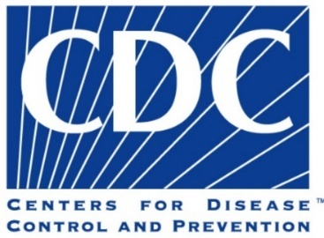


GDD Regional Detection Centers
10 locations: Bangladesh, Central America (Guatemala), Central Asia (Kazakhstan), China, Egypt, India, Kenya, South Africa, the South Caucasus (Georgia), & Thailand
Selection based on 5 factors: public health significance, country commitment, established CDC presence, established regional reach, & international partner presence
Notes:
A central focus of GDD is the establishment and expansion of GDD Regional Centers, particularly in resource-constrained locations. CDC currently operates 10 GDD Regional Centers in the following locations: 1) Bangladesh, 2) Central America (Guatemala), 3) Central Asia (Kazakhstan), 4) China, 5) Egypt, 6) India, 7) Kenya, 8) South Africa, 9) the South Caucasus (Georgia) and 10) Thailand.
Global Disease Detection Regional Centers are located in all WHO regions. Together with partners, Centers work directly with ministries of health to identify, control and combat priority infectious diseases. Regional Center locations are selected in consultation with invited countries, internal experts, WHO, and national and international partners, and is based on:
Public health significance: The country has a high population density or history of infectious diseases or expected potential for emerging diseases;
Country commitment: The country supports and values partnership with CDC and will actively engage in collaborative activities and identify new partners;
Established CDC presence: The country has an established, effective working relationship with CDC and supports CDC staff in-country;
Established regional reach: The country has the infrastructure and regional stature to serve as regional resource, or is already acting as a regional leader in other arenas;
International partner presence: The country has other U.S. Government agencies and international partners operating in-country.
Sources:
Montgomery, J.M., Woolverton, A., Hedges, S. et al. Ten years of global disease detection and counting: program accomplishments and lessons learned in building global health security. BMC Public Health 19, 510 (2019). https://doi.org/10.1186/s12889-019-6769-2
https://www.cdc.gov/globalhealth/healthprotection/gdd/about.html

Slide 7

Key Accomplishments 2006-18
Outbreak response: >2375 outbreaks & other PH emergencies in 62 countries
Discovered 83 pathogens for first time in a country, 11 new to world & 7 with new mode of transmission
Trained >131,500 worldwide in >4000 training sessions
Strengthened PH Lab system-introduced
545 diagnostic tests to country labs &
certified > 400 BSCs
Notes:
Between 2006-2018, the GDD Program accomplished the following: (this is not an exhaustive list)
Outbreak Response- Responded to more than 2375 disease outbreaks and other public health emergencies, including Ebola, anthrax, chikungunya, and influenza H7N9. Technical assistance included boots-on-the ground field response, the introduction of laboratory diagnostic tests and emergency response assistance to other PH emergencies, such as natural disasters. Response time for requests for assistance was 24 hours in 62% of the requests and an additional 19% between 24-48 hours. Sixty-seven percent (67%) of outbreaks received laboratory support and of these, 85% were given a confirmed cause of the outbreak.
Pathogen Detection & Discovery- Detected & identified 83 pathogens that were new to the region in which they were discovered, of which 11 were new to the world and 7 presented with a new mode of transmission.
Training- The GDD Program helped build a global health workforce to improve the quality of epidemiology and laboratory sciences, thus improving country capacity to prevent, detect, and respond to new threats.. GDD Regional Center staff and partners held nearly 4,000 training sessions and trained more than 131,500 health care and public health professionals in a range of topics including, but not limited to: 1) Epidemiology, Surveillance, and Laboratory; 2) Emergency Management; and 3) Health and Risk Communication.
Strengthening of Public Health Laboratory Systems-Introduced 545 diagnostic tests to country labs, and certified over 400 biological safety cabinets (BSCs) by supporting biosafety certification.
Source:
Global Disease Detection (GDD) Program: 2004-2018 History and Accomplishments; https://www.cdc.gov/globalhealth/healthprotection/gdd/gdd-accomplishments.html?CDC_AA_refVal=https%3A%2F%2Fwww.cdc.gov%2Fglobalhealth%2Fhealthprotection%2Fgdd%2Fwhat-we-do.html

Slide 8
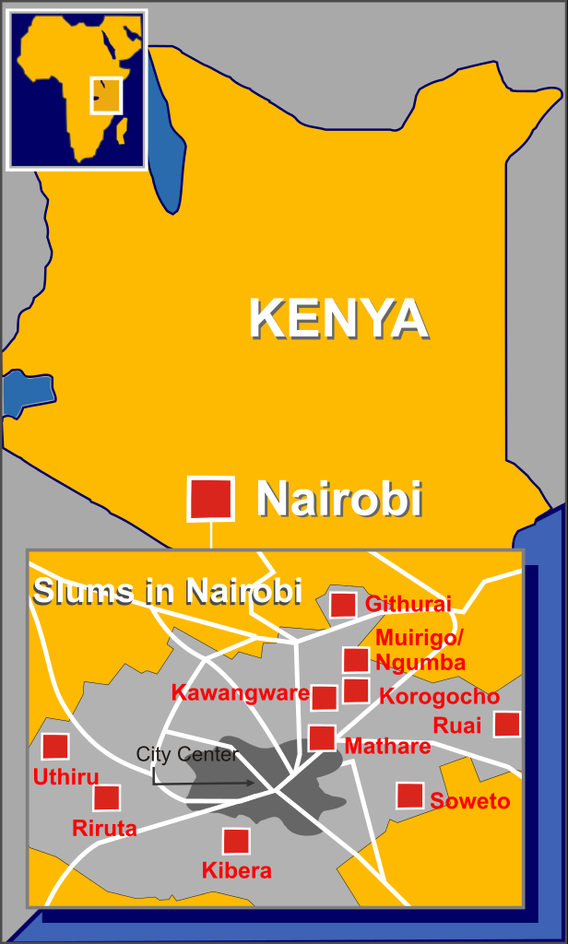
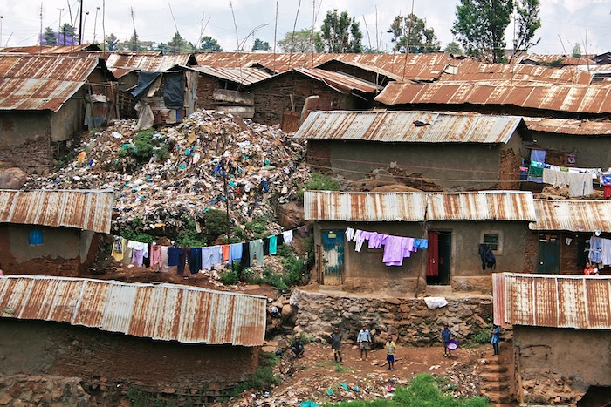
Surveillance in Kibera, Kenya
Click on this link: http://www.cdc.gov/globalhealth/video/gdd/inkibera.htm
https://upload.wikimedia.org/wikipedia/commons/d/df/Kibera_Nairobi_Kenya_slums_shanty_town_October_2008.jpg
Notes:
Click on the link on this slide or cut and paste the link into your browser. It links to a 5 ½ minute video on global disease surveillance being conducted in Kibera, Kenya. Kenya is one of the GDD Centers. This mini-documentary chronicles how the U.S. reaches out to Kenya's largest poverty-stricken area to offer aid in disease prevention and control. In Kibera, 30,000 residents routinely confer with community outreach workers in a surveillance campaign to learn more about emerging diseases, and simultaneously provide care for the families taking part. This provides a case example of surveillance in a low resource setting or LRS., Infectious diseases cross all borders, but those affecting low resource settings create additional surveillance challenges. These includes Ebola virus and COVID-19. Global health security is not just a health issue; a crisis such as SARS or Ebola can devastate economies and keep countries from developing. The World Bank Group estimates that Guinea, Liberia, and Sierra Leone together will have lost at least $1.6 billion in forgone economic growth in 2015 as a result of the Ebola epidemic. The impact of this kind of economic devastation reaches farther and wider than ever.
Source of map image: https://upload.wikimedia.org/wikipedia/commons/thumb/0/04/Nairobi_slums_area.svg/616px-Nairobi_slums_area.svg.png

Slide 9

Surveillance in Low-resource Settings (LRS): What is Available?
↑#s of organizations, partnerships, global & regional networks: WHO, GAVI, GFATM, Bill & Melinda Gates, google.org, Rockefeller
↑ support networks: INDEPTH, IEIP, GDD
Can provide additional resources
Can create new challenges
See Table 17-1 in supplemental reading
Notes:
We will now outline issues regarding surveillance in low-resource settings (LRS). There are an increasing number of organizations, partnerships, regional and global networks operating within the global domain of surveillance. The World Health Organization (WHO) still provides overall global leadership on public health surveillance but operates with decreased funding within a number of increasing organizations. Examples of others include the Global Alliance for Vaccines and Immunizations (GAVI), the Global Fund for AIDS, TB and Malaria (GFATM), Google.org, the Bill and Melinda Gates Foundation, and the Rockefeller Foundation. There has also been a rise in networks that support, coordinate and harmonize surveillance. These include the INDEPTH Network, Demographic Surveillance Systems, International Emerging Infections Program (IEIP) and as we have discussed earlier, the Global Disease Detection Program. Such programs can be of immense benefit to poorer countries as they often provide additional resources, new partners with which to interact and gain support for surveillance activities, and assistance with new technologies. On the other hand, new challenges can be created. There is no “relied upon formula” by which organizations or partners distribute resources. Engaging in partnerships and receiving resources might entail the countries being assisted to have to purchase or use equipment that complicates already existing broader surveillance programs. In addition, such countries may then divert efforts and resources from the national health system in order to participate in specific surveillance projects for which they have received funding.
References: Supplemental text reading, pages 357-362.

Slide 10

Choice of Surveillance in LRS
Structured-traditional with defined # of specific diseases or conditions of high priority
Unstructured- event-based to information about potential health threats (e.g., emerging diseases)
How do LRS decide? Choice often involves compromises between desirable attributes
Factors: timeliness, representativeness, sensitivity, specificity, costs
See table 17-2 in supplemental reading
Notes:
Surveillance systems can be classified as structured vs. unstructured. Structured systems, like you learned about in the first 2 weeks of the course, involve a defined number of diseases or conditions of high priority. This type of system has also been referred to as routine surveillance, indicator-based surveillance and surveillance for notifiable conditions. The WHO Standards for Surveillance and the U.S. National Reportable Disease requirements are examples of structured surveillance systems. The effort to detect information about potential health threats in novel and unstructured ways has led to new system types, with terms including event-based surveillance, bio surveillance, health situation awareness, health status monitoring, health intelligence, and others. For example , the WHO’s Global Public Health Intelligence Network (GPHIN) gathers official reports and rumors of suspected outbreaks from a wide variety of formal and informal sources. Formal sources would include ministries of health, WHO regional and country offices, civilian and military laboratories, to name a few. Informal sources would include electronic media and electronic discussion groups. This system is primarily focused on communicable diseases but also identifies related conditions such as food and water safety and chemical events. How do LRS select the appropriate surveillance approach? There is no one best approach and the choice is dependent upon several factors. Often the choice involves a compromise between timeliness and representativeness, sensitivity vs. specificity and costs. Direct costs would include printing for forms for reporting, computer hardware and software. Indirect costs would include the time personnel spend on entering information, as well as political costs to governments when reporting diseases may negatively impact tourism. In fact, failure of a surveillance system may occur from not considering all of the costs for a particular system.

Slide 11

Important LRS Surveillance Terms
Coordination- maintain mutual awareness of activities & promote efficiencies, while not changing actual processes of involved systems
Harmonization- different surveillance systems adhere to same norms, rules, processes to eventually achieve interoperability
Integration- developing common set
of procedures shared by all
Examples: see transcript
See table 17-3 in supplemental reading
Notes:
The course text provides information regarding three terms that describe efforts to improve efficiency and effectiveness of surveillance in LRS. The first is “coordination”, which is described as the “lightest” of the three. Coordination refers to “efforts to maintain mutual awareness of activities and promote efficiencies, while not changing the actual processes of any of the involved surveillance systems”, with the main purpose being “sharing of resources for the common good”. The example provided relates to a laboratory network developed in Rwanda for HIV/AIDS testing. The Rwandan government wished to establish a national laboratory for communicable disease surveillance that extended its capacity beyond HIV/AIDS. Funds were provided for a common purpose so that the objective of HIV/AIDS testing was achieved and this effort also enhanced the overall laboratory capacity for the country by sharing resources, training and requirements.
The second term is “harmonization”, defined as “the attempt to require that different surveillance programs each independently adhere to the same norms, rules, and processes resulting in convergence to eventual interoperability of those systems.” Examples of processes include data standards, standardized data dictionaries, data interfaces and software development standards. Harmonization assists in establishing the basis for truly integrated systems of health information and surveillance. One example is the ICD or International Classification of Diseases which is a global health information standard for morbidity and mortality statistics. It is used to define diseases and study disease patterns, as well as to manage health care, monitor outcomes, and allocate resources.
“Integration” of systems is described as the most “ambitious” of the three terms, and defined as “development of a … common set of procedures shared by all”. The WHO has promoted an integrated approach to surveillance since the 1990s. The Regional Office for Africa (AFRO) of the WHO designed the Integrated Disease Surveillance and Response Strategy (IDSR) in 1998. Within this system, they have established “thresholds for action” to different types of public health data. One example would be that for cholera, a single suspected case requires 5 specific response actions, such as reporting the case-based information immediately as well as treating according to national guidelines. Several other examples of how this integrated system can be implemented are provided in Table 17-3 of the course text.
References:
Supplemental reading, pages 370-373
http://www.who.int/classifications/icd/factsheet/en/

Slide 12

Enabling Surveillance in LRS
Legal, administrative & financial structures
Facilitation of communication among health-related agencies within the government
Quality laboratory capacity
Adequately staffed & trained workforce
Political commitment & leadership, including “mentoring” of newly trained workforce
Notes:
In order for LRS to achieve optimum surveillance capacities, there are several essential requirements. First, it is imperative that there are governmental and administrative structures that support diverse surveillance activities simultaneously and use scarce human and financial resources efficiently. Initial investments and financial commitments may be offset in the future by savings from improving the efficiency in health-care systems. Next, communication among health-related agencies within the government should be facilitated, for example, among those responsible for vital statistics, food and drug administration and medical research. There are examples of national public health agencies whose countries have been successful in grouping essential public health capacities under one organizational structure. These include the Centers for Disease Control & Prevention (CDC), the Finnish National Public Health Institute (KTL), and the United Kingdom’s Health Protection Agency (HPA). A systematic approach is necessary to improve the quality of laboratory testing in LRS by developing standardized reporting, process control, safety and training. Standardization and sharing of procedures and protocols can be accomplished by promoting the establishment of laboratory networks, like that of the Jordan Ministry of Health. Public health laboratorians often join the weekly surveillance meeting to share vital information and contribute to team building. An adequately staffed and trained workforce should include frontline surveillance personnel, epidemiologists, public health laboratorians, and informatics specialists. Field epidemiology and training programs (FETPs) provide 2-years of training in surveillance, outbreak response, and public health program management to ministry of health personnel. Graduates of such programs are often able to serve in surveillance leadership roles at the federal or local level. A final requirement is political commitment and leadership, which includes a culture of evidence-based decision making and mentoring of newly trained workforce members as they apply their skills in practice. Political commitment is enhanced when those persons making decisions on a policy issue can easily access public health surveillance systems and utilize information from these systems.

Slide 13
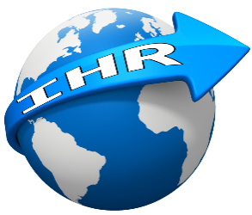
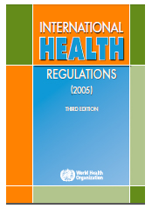
International Health Regulations (IHR)
Instrument of international law
Create rights/obligations for countries & criteria to determine PHEICs
Formulated for responding to globalization
& increasing travel & trade
Designed to protect country from risks
not controlled on national level
↑ global health security by rapid info. spread & promote collaboration for faster response
Notes:
We will now introduce the International Health Regulations, which influence surveillance efforts on a global scale. The International Health Regulations (IHR) were revised in 2005. IHRs are an instrument of international laws that are legally-binding in 196 countries, including the 194 WHO Member States. The primary purpose of IHR is to determine the rights and obligations for member countries at the time of a public health event, including the requirement to report public health events. IHR outline the criteria to determine what event constitutes a Public Health Emergency of International Concern. The updated IHR focus on informing epidemiologic intelligence with a shift from classical disease-based epidemiology to an event-based all-hazard approach, including hazards belonging to non-health sectors. IHR were formulated for responding to globalization and ever-increasing travel and trade. IHR are designed for protecting a country from risks that could not be controlled just on a national level or by a health sector only. IHR increase global health security by rapid spread of information. IHR also promote collaboration leading to faster response, and more effective management of new threats. IHR allow the global public health community to react faster and with more flexibility to public health events.

Slide 14

What is a PHEIC?
An extraordinary event constituting a public health risk to other States through the international spread of disease & potentially requiring a coordinated international response
A PHEIC is determined by
WHO Director-General (DG)
Notes:
A PHEIC is defined as a public health emergency or an extraordinary event constituting a public health risk to other States through the international spread of disease and potentially requiring a coordinated international response. A PHEIC is determined by WHO Director-General (DG) in consultation with a State in which an event arises and advice of Emergency Committee (EC) of outside experts. WHO informs member countries about a PHEIC, which then informs the general public. If a PHEIC is declared, WHO issues IHR Temporary Recommendations to deal with the situation.

Slide 15
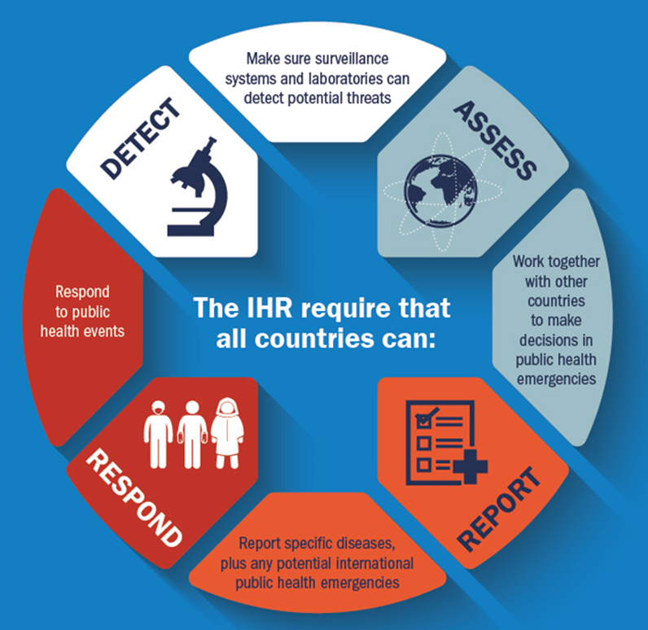
IHR
GOALS
REQUIREMENTS
Prevent
Protect against
Control
Respond
to international spread of disease
Image Source
Notes:
The goals of the revised IHR are to prevent, protect against, control and respond to an international spread of disease, while avoiding unnecessary interference with international traffic and trade. This is necessary in today’s well-connected world where infectious agents can easily spread within the country and across international borders. To achieve these goals, the IHR require that all countries can detect, assess, report and respond to any potential PHEIC. Under IHR, it must be ensured that countries have surveillance systems and laboratories that can detect potential threats. The countries need to work together with other countries to assess and make decisions during public health emergencies. IHR require that the member countries report specific diseases, plus any potential international public health emergencies to WHO. The member countries need to be able to respond to public health events.

Slide 16


Key IHR Mandates for WHO
Collect information globally on public health events
Risk assessment of the information
  potential international spread
  interference with international traffic
  risks to human health
Image source
Notes:
Under IHR, WHO is mandated to perform to perform certain tasks. WHO is required to collect information globally on public health events from the member states. It is required to assess the information about the event to determine potential international spread, interference with international traffic and risks to human health. In addition, WHO is required to request verification from countries of unofficial reports of events, disseminate public health information on events and risks, coordinate management and response to international health events, and provide advice, technical assistance etc. to all member countries.

Slide 17
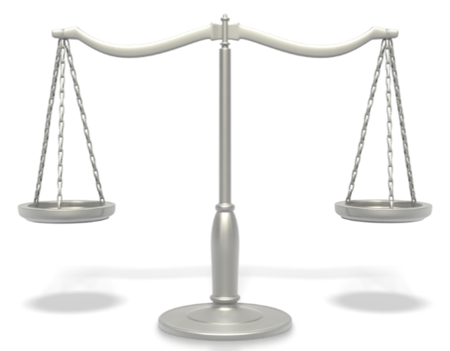
Key Obligations & Rights of
Member Countries
Obligations
  establish & operate National IHR focal Points (NFP)
  notify/report/verify potentially international health events & risks
  provide international cooperation & assistance
  develop core capabilities
Right to advice, technical support, specified info., assessments on events/risks, respect, dignity
Notes:
On this slide the key rights and obligation of member countries under IHR are presented. The most important obligations of member countries are establishing and operating a National focal point (NFP) and notifying, reporting, or verifying a potentially international health events and risks. In addition, member countries are required to provide international cooperation and assistance, develop core capacities for surveillance, response, and points of entry control. Similarly, under IHR member countries have right to advice, technical support, information, and assessments on events/risks from WHO. They are also entitled full respect for dignity, human rights and fundamental freedoms of persons.

Slide 18

Establishment of NFPs
Designate a National Focal Point (NFP)
Required functions of (NFP):
  24/7 availability for communications with WHO
  Sending to WHO IHR Contact Point urgent communications concerning IHR
  Colleting information
  Disseminating IHR information
NFP
Notes:
As mentioned previously, all countries must designate a point of contact, called the National Focal Point (NFP), for communication to and from WHO at all times. The NFP is required to perform the following functions:
to be available 24/7 for communications with WHO
to send to WHO IHR Contact Point, urgent communications concerning IHR.
to collect information from all relevant sectors of the administration and
to disseminate IHR information to all relevant sectors of the administration.

Slide 19
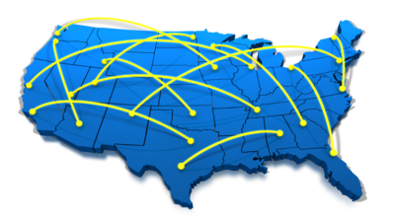
NFP - United States
The Secretary’s Operation Center (SOC) at Department of Health & Human Services serves as NFP
CDC works with state & local reporting
& response networks to receive info. at federal level; then respond to events of concern at local & federal levels
IHR form foundation for CDC’s global health security agenda
Notes:
The Secretary’s Operation Center at the Department of Health and Human Services serves as the National Focal Point for the United States. It notifies WHO of potential public health threats in the United States that meet the assessment criteria under IHR. The assessment is largely conducted by senior scientists at CDC. CDC invites the relevant state epidemiologist and representatives from the Council of State and Territorial Epidemiologists to join the assessment. The assessment is performed within 48 hours of becoming aware of an event that could merit reporting to WHO. CDC becomes aware of events through many different sources (e.g., routine disease notification systems, media reports, anecdotal reports by astute public health practitioners). In the U.S., CDC works with state and local reporting and response networks to receive information at the federal level and then respond to events of concern at the local and federal levels. The Department of Health and Human Services (DHHS) has assumed the lead role in carrying out the reporting requirements for IHR (2005). The IHR also form the foundation of CDC’s global health security agenda.

Slide 20

Notify Potential PHEIC
4 decision criteria:
  Is the public health impact of this
  event potentially serious?
  Is this event unusual or unexpected?
  Is there the potential for international spread?
  Is there the potential for travel & trade restrictions?
If 2/4 criteria met, countries required to notify event/risk to WHO (48 hours for assessment; reporting required within 24 hours of assessment)
Notes:
One of the most important duties of an NFP is to detect and report events that may constitute potential international health events and risks. Under IHR, any event that meets 2 of 4 criteria below needs to be reported to WHO:
1. Is the public health impact of the event serious?
2. Is the event unusual or unexpected?
3. Is there a significant risk of international spread?
4. Is there a significant risk of international travel or trade restrictions?⁷
Once an event of concern is identified, the country must assess the public health risks of the event within 48 hours. If the event is determined to be notifiable under the IHR, the country must report the information to WHO within 24 hours of assessment.

Slide 21
IHR Decision
Instrument
Tool for assessment & notification of events that may constitute PHEIC
Detailed instructions for use available
Source
Notes:
Annex 2 shown on the slide is the decision instrument for the assessment and notification of events that may constitute a PHEIC. The decision instrument is present in the International Health Regulation (2005), Third edition. The document can be retrieved from https://www.who.int/publications/i/item/9789241580496. WHO has also created detailed tutorials for using the Annex 2 for reporting of potential events of public health emergency of international concern. The instructions can be accessed at: https://www.who.int/publications/m/item/tutorials-on-the-use-of-annex-2-of-the-international-health-regulations-(2005).
This decision instrument has been supplied as a Supplemental Resource for better viewing.

Slide 22
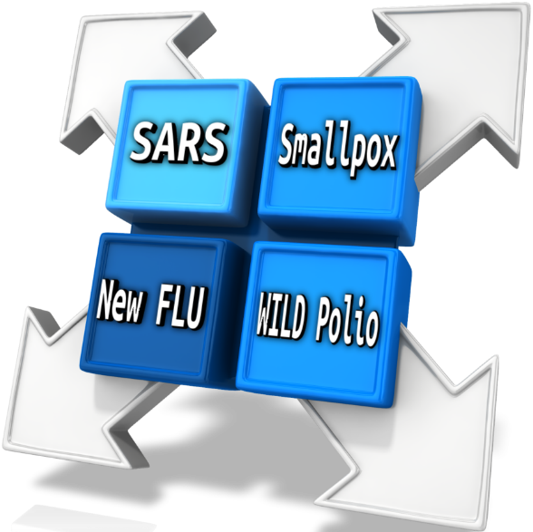
Always Notifiable IHR PHEIC
Under IHR 4 diseases always need to be reported to WHO:
  SARS
  smallpox
  new influenza viruses
  wild-type polio
Notes:
Some diseases are always reportable under IHR, no matter when or where they occur, while others become notifiable when they represent an unusual risk or situation. The diseases that are always notifiable include smallpox; poliomyelitis due to wild-type poliovirus; human influenza caused by a new subtype; and severe acute respiratory syndrome (SARS).

Slide 23

Other Potentially Notifiable Events
Cholera
Pneumonic plague
Yellow fever
Viral hemorrhagic fevers
West Nile fever
Any others that meet IHR criteria
Other biological, radiological or chemical events that meet IHR criteria
IHR
events
Notes:
There are additional potentially notifiable events according to the IHR, when they represent an unusual risk or situation. These include:
Cholera
Pneumonic plague
Yellow fever
Viral hemorrhagic fevers
West Nile fever
Any others that meet IHR criteria
Other biological, radiological or chemical events that meet IHR criteria

Slide 24

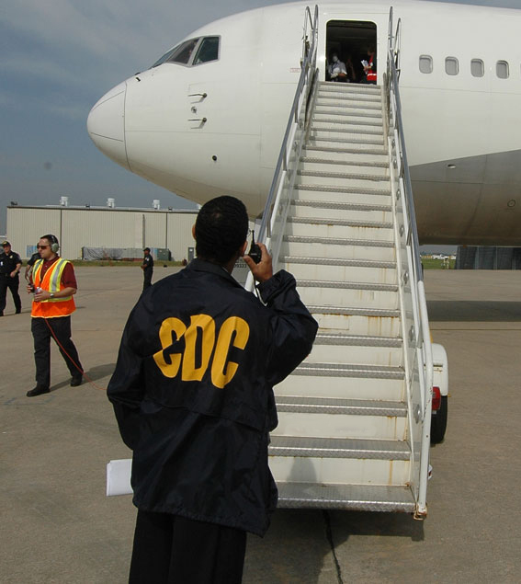
How Many PHEIC to Date?
Since IHR (2005) was put into place, 6 PHEICs
have been declared by WHO:
  H1N1 influenza (2009)
  Polio (2014)
  Ebola (2014)
  Zika virus (2016)
  Ebola (Democratic Republic
  of the Congo) (2019)
  COVID-19 (2020)
Image Source
Notes:
Since IHR (2005) was put into place, six PHEICs have been declared by WHO. They include H1N1 influenza in 2009, wild polio virus in 2014, Ebola virus spread in 2014, Zika virus outbreak in 2016, Ebola virus outbreak in the Democratic Republic of the Congo in 2019 and finally, the COVID-19 outbreak in 2020.
For more information visit: https://www.who.int/teams/ihr/ihr-emergency-committees

Slide 25
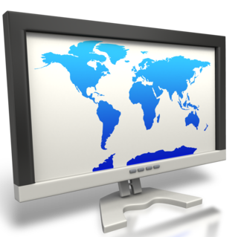
IHR Monitoring & Evaluation
IHR MEF is composed of 4 processes:
  States Parties Self-Assessment Annual Reporting (SPAR)
  Joint External Evaluations (JEE)
  After Action Reviews (AAR)
  Simulation Exercises (SimEx)
100% countries have reported at least once
Only 1/3 of countries have the ability to assess, detect & respond
Notes:
The progress of implementation of IHR is measured through the IHR Monitoring Evaluation Framework. IHR MEF is composed of four processes:
States Parties Self-Assessment Annual Reporting (SPAR)
Joint External Evaluations (JEE)
After Action Reviews (AAR) and
Simulation Exercises (SimEx).
The SPAR is a mandatory process under IHR (2005); the JEE, AAR, and SimEx are voluntary. The SPAR is a self-assessment tool to monitor progress of IHR implementation. The tool consists of 24 indicators for the 13 IHR capacities. All member countries have reported SPAR data at least once after implementation of IHR.
However, in spite of broader global agreement to the importance of IHR (2005), only about 1/3 of the countries in the world currently have the ability to assess, detect, and respond to public health emergencies. These gaps in global preparedness leave the U.S. and the rest of the world vulnerable.

Slide 26
IHR Score per capacity, all WHO Regions 2019
Global Average Indicator C6 Surveillance
All Countries 2018-2022
13 core capacities
WHO_E-SPAR
Notes:
The WHO provides an Electronic State Parties Self-Assessment Annual Reporting Tool (e-SPAR) as part of the IHR MEF. It is a web-based platform utilized by State Parties to fulfil their obligation to report annually to the World Health Assembly (WHA) on the implementation of 13 capacity requirements under IHR and to encourage the transparency and mutual accountability between States Parties towards global public health security. The 13 core capacities are:
Legislation and financing
Coordination
Zoonotic events
Food safety
Laboratory
Surveillance
Human resources
Health emergency framework
Health service provision
Risk communication
Points of entry
Chemical events
Radiation emergencies
On the top part of this slide is a result of a self-assessment of scores in each of these 13 areas, as of 4/17/2020, by WHO Region. Note the circled area for surveillance. On the bottom part of the slide is a graph of the global average for just the surveillance indicator, for all countries’ self assessment, for 2018 and 2019. You are encouraged to go to the E-spar link and use it to view th0se on a larger scale and for different categories of interest to you. Please note: As this website is updated frequently, the numbers on the e-SPAR site may not be the same as those on this slide when you view it.
Source: https://extranet.who.int/e-spar

Slide 27
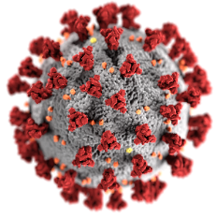
Original Timeline IHR & COVID-19
12/31/2019- WHO’s Country Office in People’s Republic of China notifies IHR focal point viral pneumonia’ in Wuhan
01/01/2020- WHO requests more information
01/03/2020- China provided information to WHO on cluster of cases of ‘viral pneumonia of unknown cause’
01/09/2020 - Novel coronavirus determined to be the cause
0/15/2020 - Japan reports first COVID-19 case to WHO
01/22 & 01/23/2020 - IHR Emergency committee (EC) meeting determines outbreak is not PHEIC due to lack of information.
01/24/2020 - France reports 3 cases of COVID-19 to WHO
01/30/2020 - COVID-19 outbreak is declared a PHEIC by IHR EC
Source
Notes:
The COVID-19 pandemic provides an opportunity to see IHR in action. The timeline of early events during COVID-19 and WHO’s response are shown on this slide.
On December 31, 2019, the WHO’s Country Office in the People’s Republic of China picked up a media statement by the Wuhan Municipal Health Commission from their website on cases of ‘viral pneumonia’ in Wuhan. The Country Office notified the International Health Regulations (IHR) focal point.
On January 1, 2020, WHO requested more information from People’s Republic of China.
On January 3, 2020, China provided information to WHO on the cluster of cases of ‘viral pneumonia of unknown cause’.
On January 9, 2020, a Novel Coronavirus was determined to be the cause of the outbreak of viral pneumonia.
On January 15, 2020, Japan reported its first case of COVID-19 to WHO.
On 22nd and 23rd January 2020 the IHR Emergency Committee (EC) met and determined that the outbreak is NOT a PHEIC. The decision was made based on the information available and committee decided to reconvene in 10 days.
On January 24, 2020, France reported 3 cases of COVID-19 to WHO. On January 30, 2020, the EC declared the ongoing COVID-19 outbreak as a PHEIC and provided temporary recommendation under IHR.
A detailed interactive timeline of WHO’s response COVID-19 and IHR in action can be accessed at: https://www.who.int/news/item/29-06-2020-covidtimeline . You are encouraged to access this link and review how COVID-19 has been managed as a PHEIC under the IHR.

Slide 28

More Recent Timeline
9/21/20-WHO’s Strategic Advisory Group of Experts on Immunization provided interim guidance for influenza vaccination during the COVID-19 pandemic
10/1/20-WHO published a call for expressions of interest for manufacturers of COVID-19 vaccines to apply for approval for prequalification and/or Emergency Use Listing
11/10/20-WHO launched ‘We Are #InThisTogether’ campaign
to promote collaboration & adherence to 5 key measures to counter COVID-19: cleaning hands, wearing masks, coughing/sneezing safely, keeping distant & opening windows
11/20/20-WHO published guideline on COVID-19 therapeutics, with conditional recommendation against use of remdesivir in hospitalized patients, regardless of disease severity
Notes:
Continuing with the COVID-19 timeline as a PHEIC, there are four more events on this slide.
9/21/20-WHO’s Strategic Advisory Group of Experts (SAGE) on Immunization provided interim guidance for influenza vaccination during the COVID-19 pandemic
10/1/20-WHO published a call for expressions of interest for manufacturers of COVID-19 vaccines to apply for approval for prequalification and/or Emergency Use Listing.
11/10/20-WHO launched ‘We Are #InThisTogether’ campaign
to promote collaboration & adherence to 5 key measures to counter COVID-19: cleaning hands, wearing masks, coughing/sneezing safely, keeping distant & opening windows
11/20/20-WHO published guideline on therapeutics & COVID-19, including conditional recommendation against use of remdesivir in hospitalized patients with COVID-19, regardless of disease severity
We are likely to be dealing with this as a PHEIC during the foreseeable future.

Slide 29

COVID-19 E.C.
IHR Emergency Committee (EC) continues to meet regularly
Issues: treatment, vaccines, precautions
Progress & challenges-can be matter of perspective
https://www.who.int/groups/covid-19-ihr-emergency-committee
Notes:
The IHR COVID-19 Emergency Committee (EC) continues to meet on a regular basis. Issues include, as examples, treatments, vaccines, and precautions. Click on the link on the slide and in the transcript to see the statements for all of the EC meetings held to date. As this pandemic has lasted over a year, there have been both progress and challenges with the management of this pandemic. These may differ between persons and countries, and can be a matter of perspective. For examples, some countries may believe they have not received an equitable amount of vaccine in their communities while others may have enough supply. Access to treatments, messaging regarding wearing masks and social distancing can be effective in some areas and not in others. A supplemental reading with an opinion article about the management of COVID-19 under the IRH has been provided as a Supplemental Resource. You may or may not agree with its content, again perhaps as a matter of perspective.
Link to Emergence Committee meetings for COVID-19 as a PHEIC: https://www.who.int/groups/covid-19-ihr-emergency-committee

Slide 30
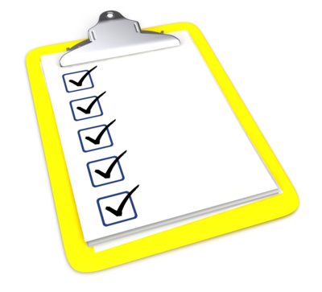
Summary
Global Disease Detection as international surveillance form
Surveillance in LRS
IHR responsibilities of countries
PHEIC
Countries’ capacity for surveillance under IHR
Case example of COVID-19 as PHEIC& challenges
Notes:
Let's summarize what we covered in this unit. First, the CDC's Global Disease Detection Program as a form of international surveillance, was discussed. Next conducting surveillance in low-resource settings was outlined. We introduced the International Health Regulations of 2005 and countries' responsibilities under the IHR. Next we assessed the surveillance capacity of countries to comply with the surveillance requirements of the IHR. Finally, we used the COVID-19 pandemic as a case example of a condition meeting the IHR's definition of a Public Health Emergency of International Concern. There have been many challenges to COVID-19 under the IHR as a PHEIC. These include travel bans within and between countries, disparities in testing and vaccine access, inconsistencies in vaccine distribution, to name some examples. IHR are necessary in today’s well-connected globe as evidenced by the ongoing COVID-19 pandemic.
Below is a list of references used for the International Health Regulations information:
https://www.who.int/health-topics/international-health-regulations#tab=tab_1
https://www.cdc.gov/globalhealth/healthprotection/ghs/ihr/index.html
https://www.cdc.gov/globalhealth/security/cdcrole.htm
https://www.who.int/data/gho/data/major-themes/health-emergencies/GHO/health-emergencies
https://www.who.int/teams/ihr/ihr-emergency-committees
This completes Unit 14 lecture (there is only one lecture for this unit).

